Slide 1
Hotel Reservation
Mohamed allam

Slide 2
Agenda
Introduction
Excel
Import Data
SQL Server
Summery

Slide 3

Introduction Hotel reservation datasets are important assets that offer insights into booking behaviors, guest preferences, and hotel operations. They provide comprehensive information about guest reservations, covering details like arrival dates, number of adults and children, room types, duration of weekend and weeknight stays, meal plans, and other relevant factors. Analyzing such data can offer valuable insights for hotel management, enabling them to refine pricing strategies, enhance guest satisfaction, and streamline operational efficiency.

Slide 4
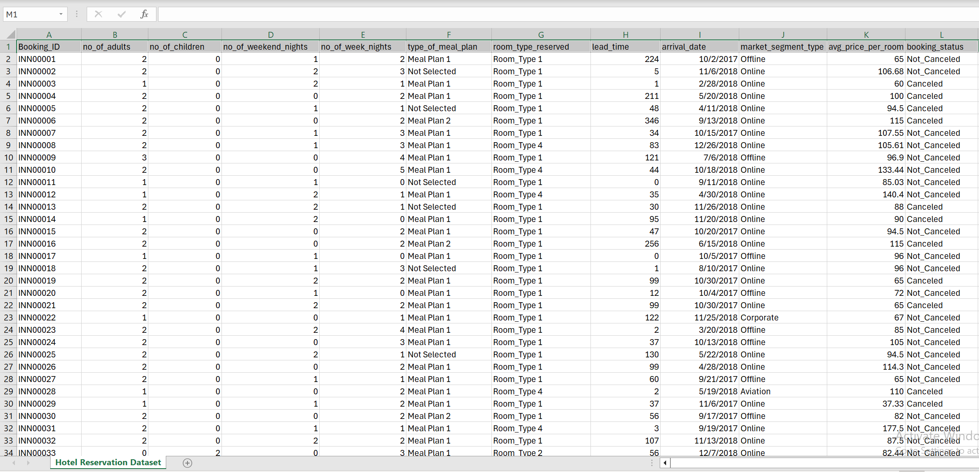
Excel
change the date format

Slide 5
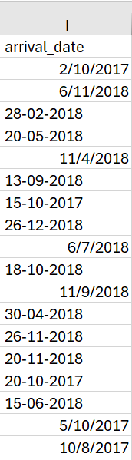
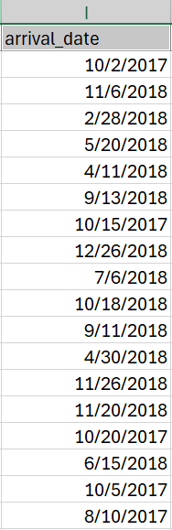
Excel
Change from this
To this

Slide 6
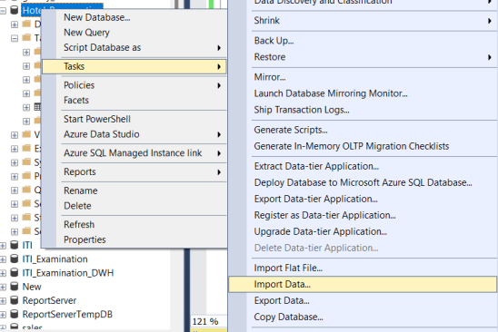
Import Data From CSV File by SQL Server

Slide 7
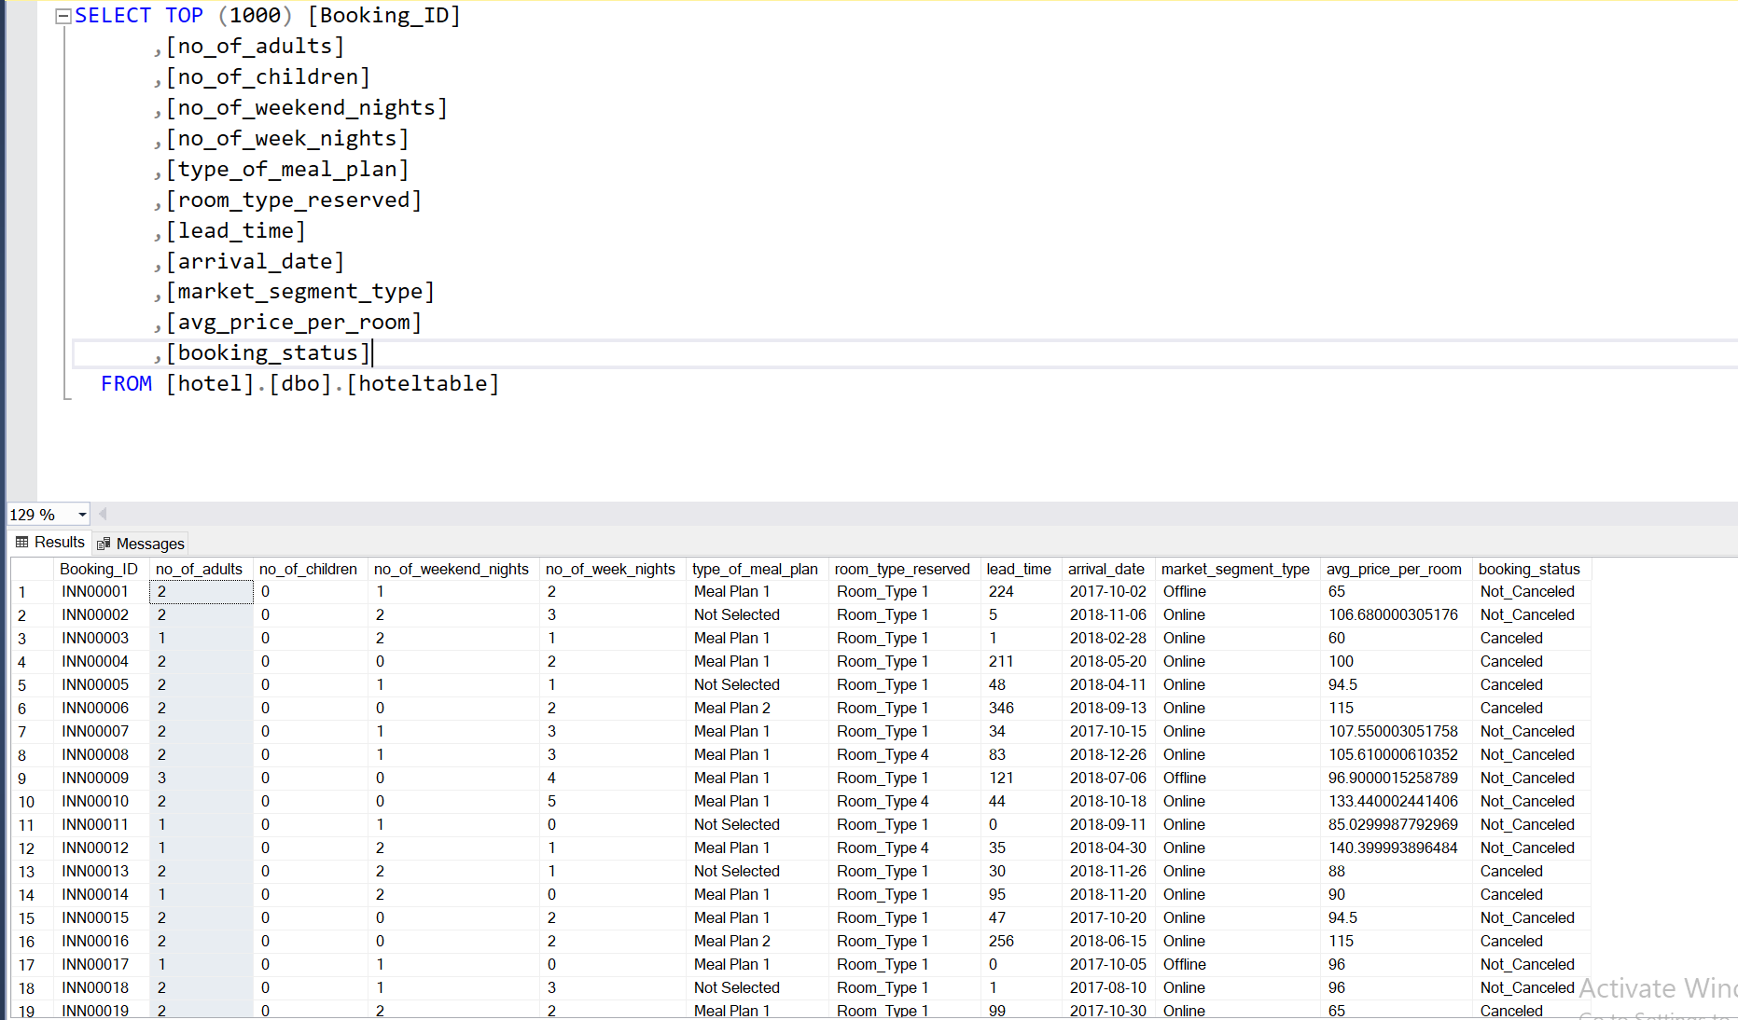
Import Data From CSV File by SQL Server

Slide 8
SQL Query
By SQL Server

Slide 9
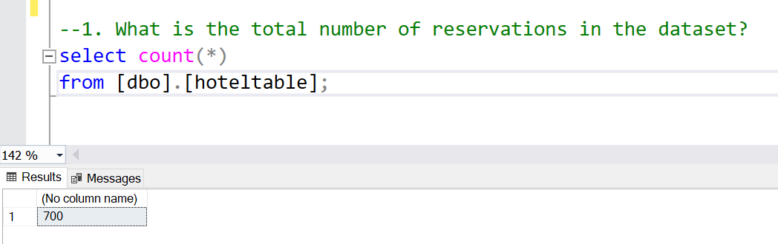
SQL Query

Slide 10
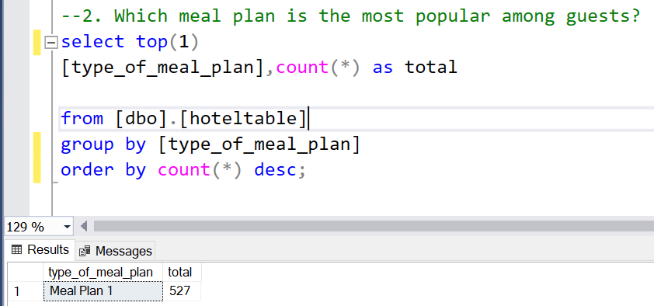
SQL Query

Slide 11
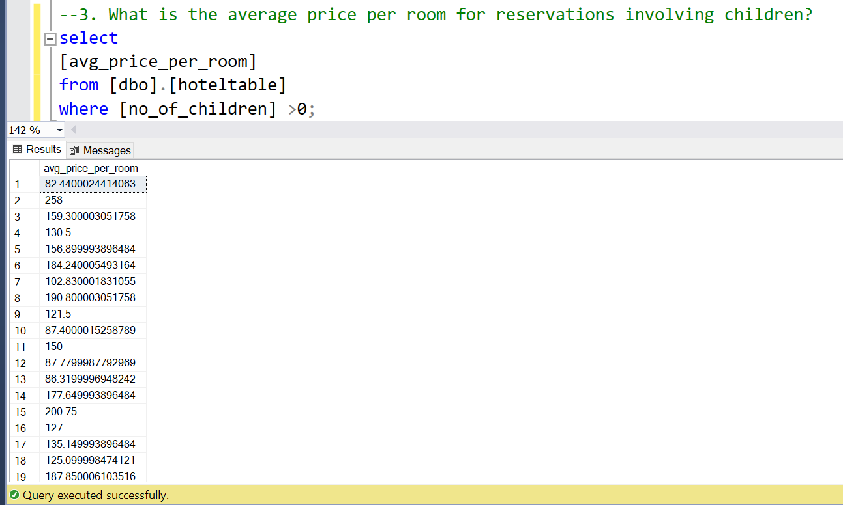
SQL Query

Slide 12
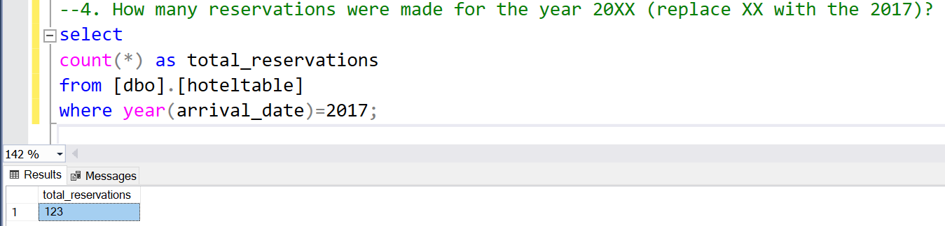
SQL Query

Slide 13
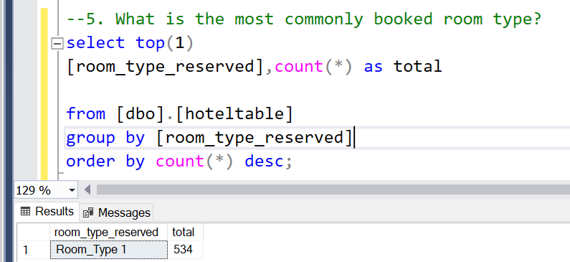
SQL Query

Slide 14
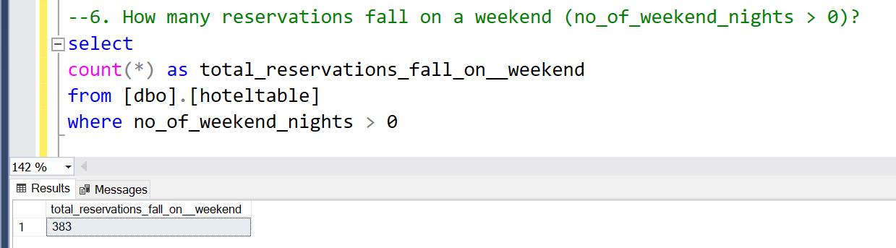
SQL Query

Slide 15
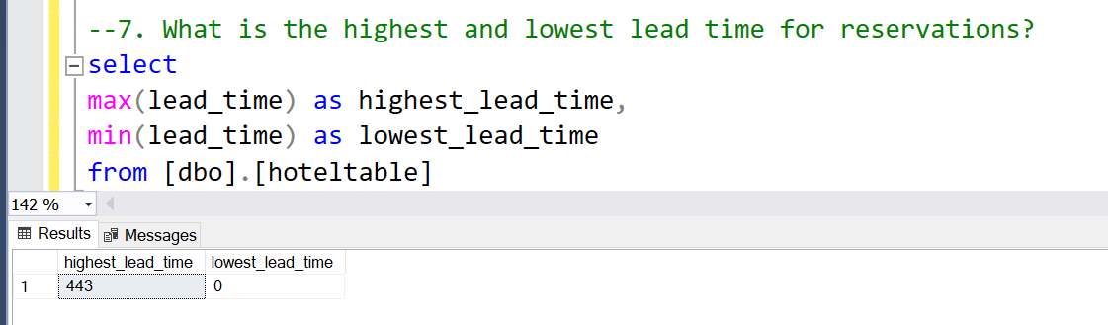
SQL Query

Slide 16
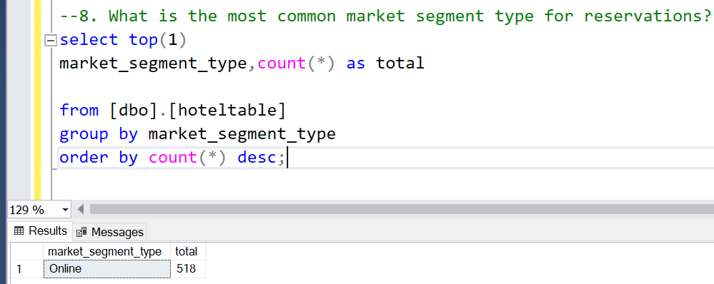
SQL Query

Slide 17
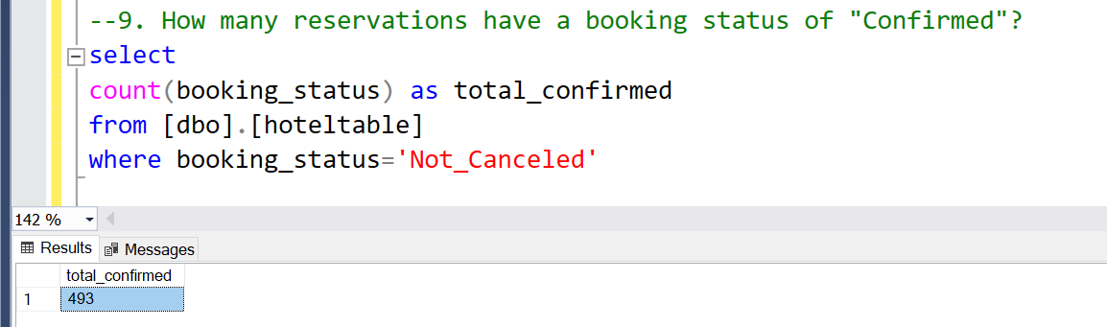
SQL Query

Slide 18
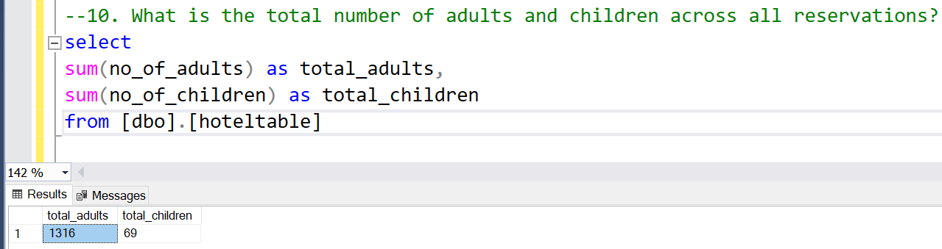
SQL Query

Slide 19
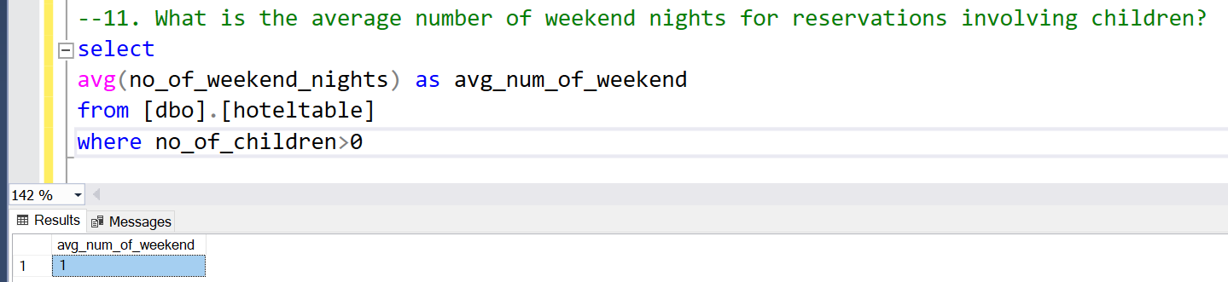
SQL Query

Slide 20
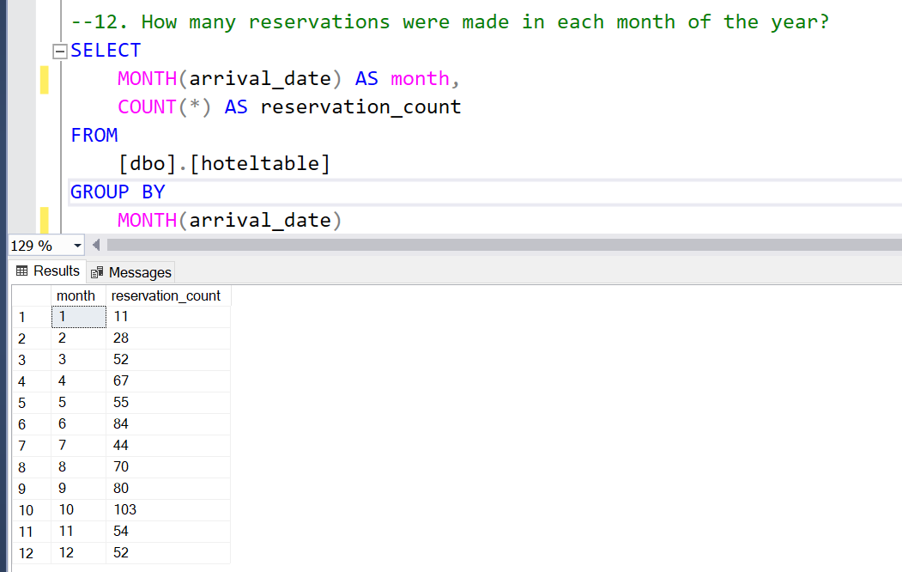
SQL Query

Slide 21
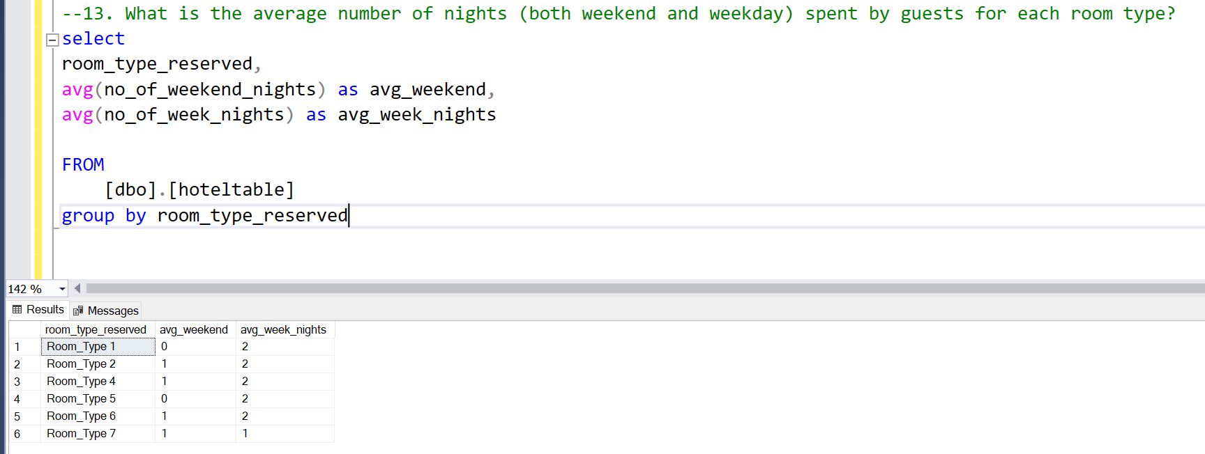
SQL Query

Slide 22
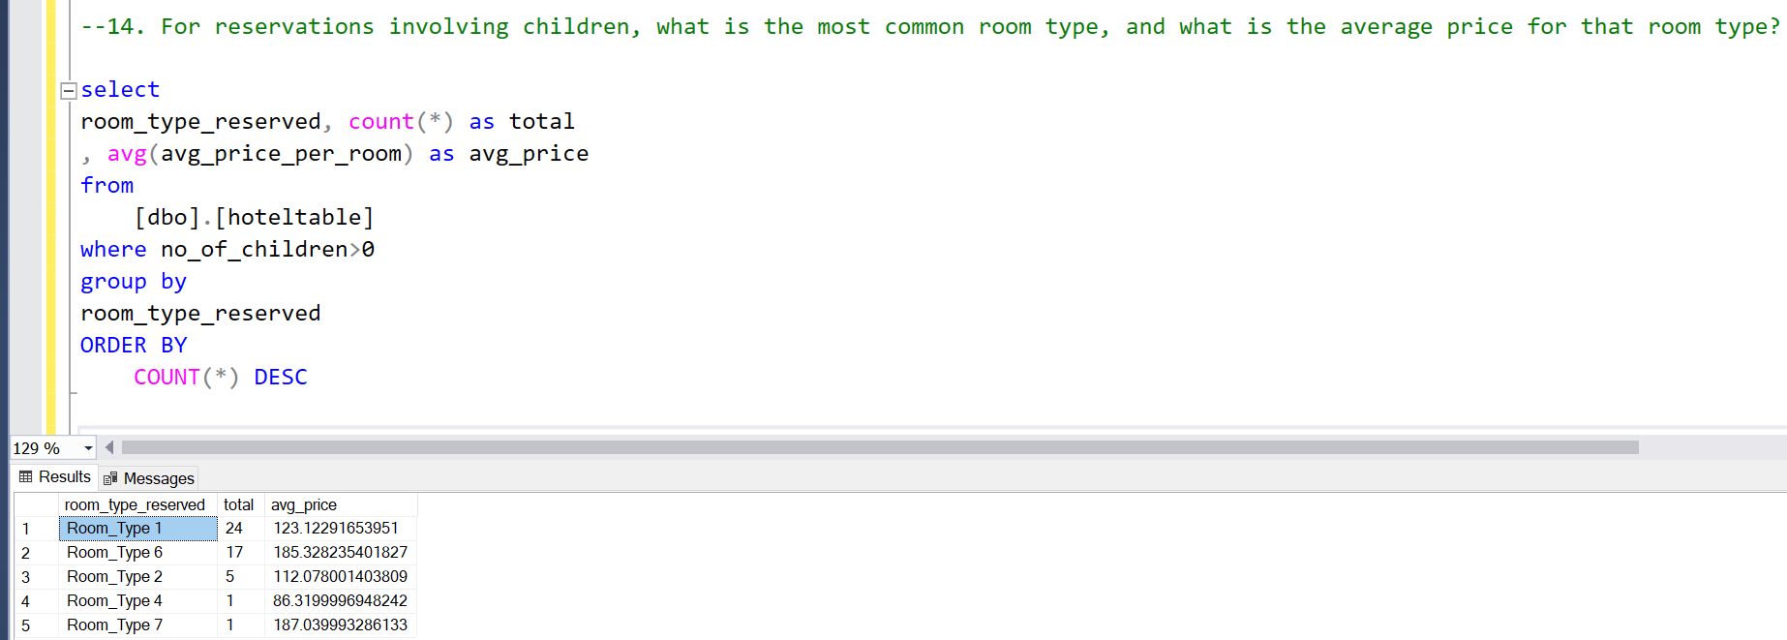
SQL Query

Slide 23
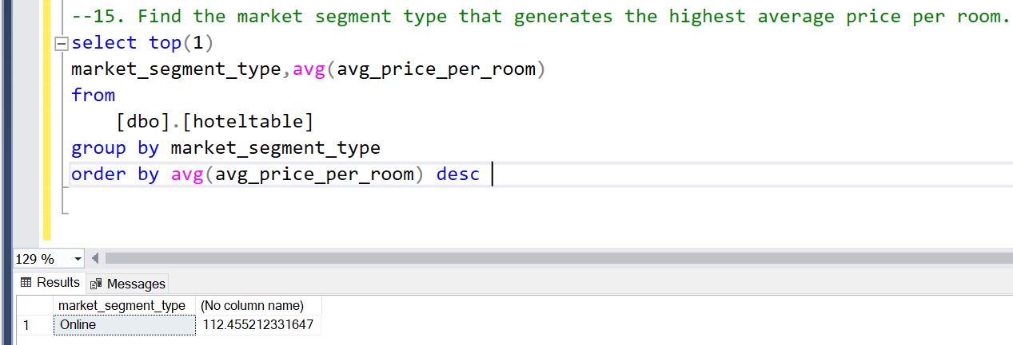
SQL Query

Slide 24
Summery SQL is a good language for dealing with databases and extracting the most important queries to analyze data efficiently and quickly.

Slide 25
Thank you MOHAMED ALLAM allammohamed3535@gmail.com

